Slide 1

Planning in the LLM Era:
Building for Reliability and Efficiency
Michael Katz Harsha Kokel Kavitha Srinivas Shirin Sohrabi
IBM

Slide 2




Motivation
Most of the focus since 2022
Environment
LLM as Planner
Observation
Action/plan
Planning/search problem in NL
Planning is central to intelligent agents
LLMs sparked renewed interest
What should we do with them?

Slide 3

Why LLM as Planner Falls Short
Unsound and incomplete methods
High computational cost per task
No reuse across tasks
Fragile to change

Slide 4
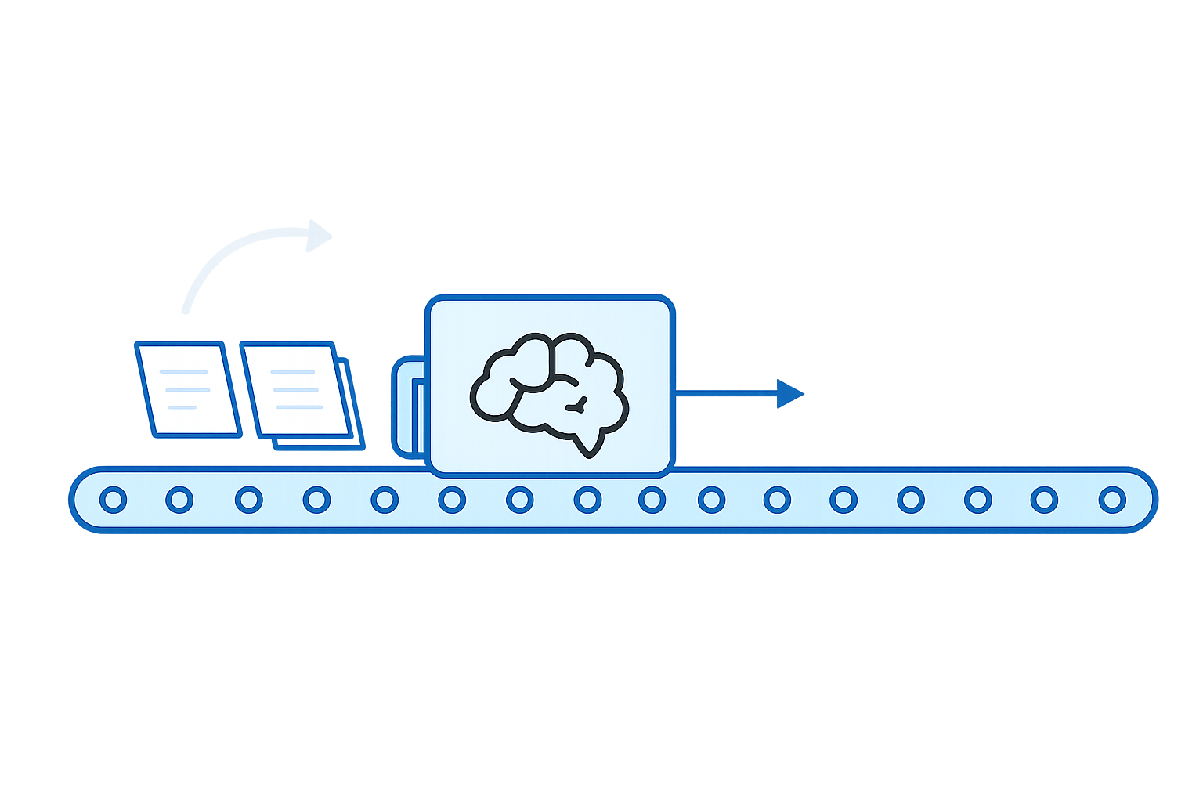

Central Idea: LLM as Solver Generator
Use LLMs mostly at construction time, not inference time
Generate a solver
Validate
Reuse efficiently
Benefits:
Reliability
Efficiency
Maintainability

Slide 5
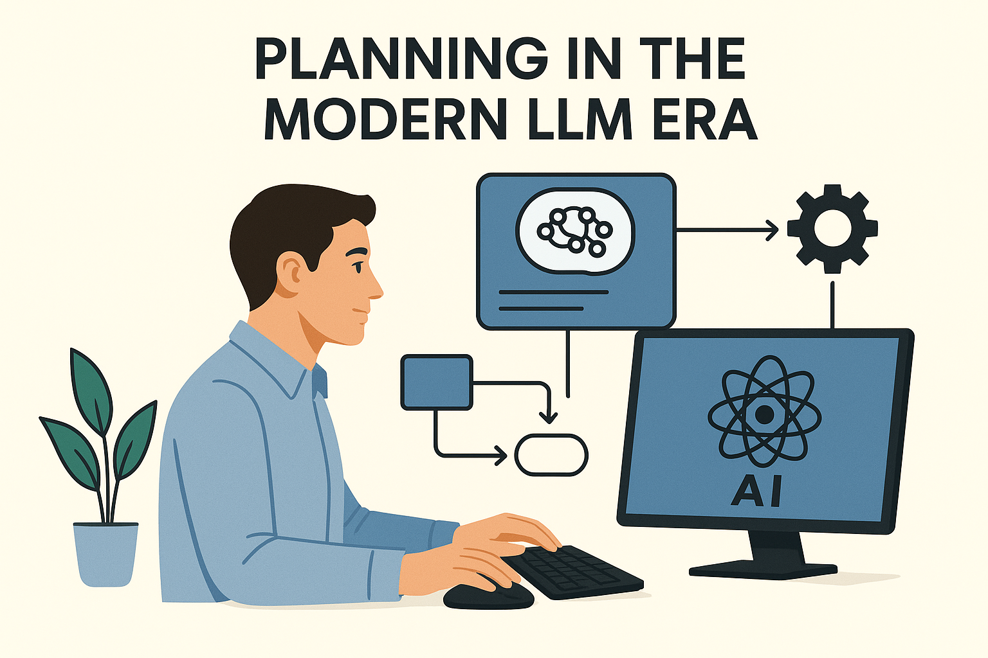

Slide 6





The Three Paradigms
Environment
Katz et al, NeurIPS 2024
LLM as search components generator
Observation
Cao et al, ICAPS 2026
Search components code (black box model)
Tuisov et al, ICAPS 2026
Action/plan
Search
algorithm
Correa et al, NeurIPS 2025
Planning/search problem in NL
Guan et al, NeurIPS 2023
Gestrin et al, HAXP@ICAPS 2024
LLM as PDDL generator
Observation
Oswald et al, ICAPS 2024
High level planning model (PDDL)
Action/plan
Huang et al, AAAI 2025
Off-the-shelf planner
Tantakoun et al, ACL Findings 2025
Oswald et al, WM@ICLR 2026
Silver et al, AAAI 2024
Hodel, BSc Thesis 2024
LLM as policy generator
Observation
Policy code
(domain-specific planner)
Action/plan
Stein et al, ICAPS 2026
Sohrabi et al, LM4Plan@ICAPS 2026

Slide 7
Search Components Generation
Environment
Katz et al, NeurIPS 2024
LLM as search components generator
Observation
Cao et al, ICAPS 2026
Search components code (black box model)
Correa et al, NeurIPS 2025
Action/plan
Search
algorithm
Tuisov et al, ICAPS 2026
Planning/search problem in NL
Open challenges:
State representation
State features learning
Find the right level of abstraction
Partial information
Hidden knowledge (initial state, goal)
Information gathering actions
Linear implementation workflow – no exploration / backtracking
Validation required
Notes:
Handcrafted or given state representation

Slide 8
PDDL Generation
Environment
Guan et al, NeurIPS 2023
Gestrin et al, HAXP@ICAPS 2024
LLM as PDDL generator
Observation
Oswald et al, ICAPS 2024
High level planning model (PDDL)
Action/plan
Huang et al, AAAI 2025
Off-the-shelf planner
Tantakoun et al, ACL Findings 2025
Oswald et al, WM@ICLR 2026
Planning/search problem in NL
Open challenges:
Same as before
Interplay between planning and execution while constructing the planning model
Non-standard features – object creation, conditional plans, loops
Procedural glue code – pagination, data tranformation
PDDL evaluation
Search in the PDDL modification space
Richer feedback mechanisms
Validation required

Slide 9
Generalized Policy Generation
Environment
Silver et al, AAAI 2024
LLM as policy generator
Observation
Hodel, BSc Thesis 2024
Policy code
(domain-specific planner)
Action/plan
Stein et al, ICAPS 2026
Sohrabi et al, LM4Plan@ICAPS 2026
Planning/search problem in NL
Open challenges:
Conceptual 2-step approach: producing algorithm and implementing
Revisit the first step if evidence of error obtained in the second
Linear implementation workflow
Validation required

Slide 10

Cross-Category Observations
Complementarity of methods
Can improve each other: e.g., transition function code can help generate PDDL
Advantages of Policy Generation
Procedural glue code natively supported
Loops, conditions, etc.
Interleaving sensing with acting is more natural
Reusable skills and hierarchical structure
Partial observability

Slide 11
Conclusions
Use LLMs mostly at construction time, not inference time
Three emerging directions:
NL2Search
NL2PDDL
NL2Policy
All show promise, but have limitations
Takeaway:
Ensure producing planners that are efficient, reliable, and able to handle the required problems

Slide 12


